Slide 1
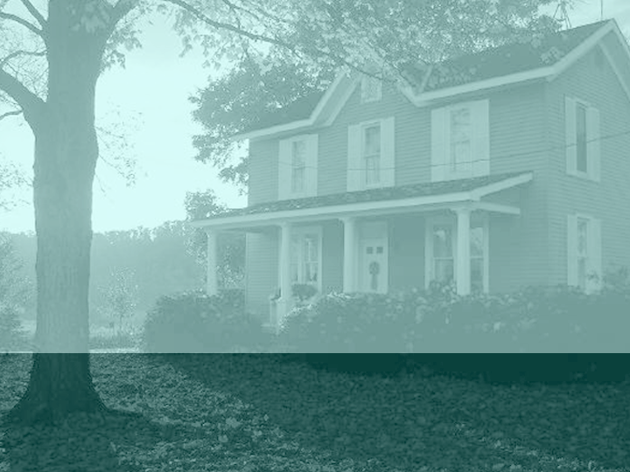
Working With Challenging Families: Effecting Change in Juvenile Justice Families
Robin Jenkins, Ph.D.
Cumberland County CommuniCare, Inc.
www.cccommunicare.org
rjenkins@cccommunicare.org
910.222.6089

Slide 2
Baumrind’s (Classic) Parenting Styles
Diana Baumrind's Theory of Parenting Styles: Original Descriptions of the Styles (1967)
Permissive ... to behave in an acceptant and affirmative manner towards the child's impulses. desires. and actions. She [the parent] consults with him [the child] about policy decisions and gives explanations for family rules. She makes few demands for household responsibility and orderly behavior. She presents herself to the child as a resource for him to use as he wishes, not as an active agent responsible for shaping or altering his ongoing or future behavior. She allows the child to regulate his own activities as much as possible, avoids the exercise of control, and does not encourage him to obey externally defined standards. She attempts to use reason but not overt power to accomplish her ends.
Authoritarian ... to shape, control, and evaluate the behavior and attitudes of the child in accordance with a set of standards of conduct, usually an absolute standard, theologically motivated and formulated by a higher authority. She [the parent] values obedience as a virtue and favors punitive, forceful measures to curb self-will at points where the child's actions of beliefs conflict with what she think is right conduct. She believes in inculcating such instrumental values as respect for authority, respect for work, and respect for the preservation of order and traditional structure. She does not encourage verbal give and take, believing that the child should accept her word for what is right.
Authoritative ... to direct the child's activities but in a rational issue-oriented way. She [the parent] encourages verbal give and take, and shares with the child the reasoning behind her policy. She values both expressive and instrumental attributes, both autonomous self-will and disciplined conformity. Therefore she exerts firm control at points of parent-child divergence, but she does not hem the child in with restrictions. She recognizes her own special rights as an adult but also the child's individual interests and special ways. The authoritative parent affirms the child's present qualities, but also sets standards for future conduct. She uses reasoning as well as power to achieve her objectives. She does not base her decision on group consensus or the individual child's desires; but also does not regard herself as infallible, or divinely inspired.
From K.H. Grobman’s web, www.devpsy.org

Slide 3
From Baumrind, How Do the Children Typically Manifest? (or, recognizing some clusters of behaviors and traits to better understand/work with children)
Background Information: Child Qualities & Parenting Styles
Authoritative Parenting
lively and happy disposition
self-confident about ability to master tasks.
well developed emotion regulation
developed social skills
less rigid about gender-typed traits (exp: sensitivity in boys and independence in girls)
Authoritarian Parenting
anxious, withdrawn, and unhappy disposition
poor reactions to frustration (girls are particularly likely to give up and boys become especially hostile)
do well in school (studies may show authoritative parenting is comparable)
not likely to engage in antisocial activities (exp: drug and alcohol abuse, vandalism, gangs)
Permissive Parenting
poor emotion regulation (under regulated)
rebellious and defiant when desires are challenged.
low persistence to challenging tasks
antisocial behaviors

Slide 4
What About Cultural Variations?
Research has shown that there are differences among European-American, African-American, Asian and other parents in terms of preferred / dominant parenting styles…
Authoritative parenting is more prevalent in Euro-Amer., while Authoritarian parenting is more prevalent in Af.Amer. and Asian families – however, cultural variations account for more positive outcomes in these families
Steinberg (2001) and others have suggested that the style of parenting interacts w/context variables (emotional exchanges, resource availability) so that Af Amer / Asian families use history, ethnic attributions and expectations, etc. to supplement authoritarian parenting so that these cultural variations account for differences in findings between European-American children and others
Chao (1994) notes that “strictness” such as conceptualized in autocratic or authoritarian families has a very different meaning in Eastern families – i.e., strictness is interpreted as, or rooted in, training (not behavioral control as in the case in Euro-Amer families). So terms such as authoritarian/autocratic have much different applications in Eastern families (esp. Chinese, Japanese)

Slide 5
Parenting Style vs. Parenting Practices
Style=Permissive, Authoritarian, Authoritative – aligned along the “control” dimension (how much behavioral control or autonomy given to the child; or along the dimension of demanding vs. lenient)
Practices=Degree to which parents engage their children in communication through the expression of warmth, empathy, display of emotion, openness to discovery, etc. (or along the dimension of high warmth and acceptance to low) – High use of control (psychological control in this sense is a negative thing…use of guilt, anger, blaming, shaming to achieve behavioral outcomes) in parenting leads to internalizing problems (anxiety, low self-esteem and poor self-image) – low control & warmth can lead to externalizing & disruptive behavior from children and other problems/issues
Parenting practices can yield counter-style outcomes --Openness in permissive parenting (bad outcomes) vs. openness in authoritative parenting (good outcomes)

Slide 6
Patterns of socialization/ types of parents
        accepting
authoritaritative
permissive
demanding
lenient
authoritarian
permissive
rejecting
Hagekull, B. (Univ. of Sweden) from Baumrind and others
Notes:
Permissive: generally non-controlling, allowing children to regulate their own behavior. Parents can show any amount of warmth – we find both highly rejecting and very warm parents here, as well as those that are in between the extremes.
Authoritarian parents have an absolute set of standards, expect unquestioning obedience and not very warm towards the child
Authoritative parents…. next

Slide 7
More on Parenting: Patterson’s Coercive Parenting Research Indicating Pathways to Child Disruptive Behavior
Patterson (1982, 1992) described a “coercive family process” whereby the conscious or unconscious use of punitive discipline, inconsistency, low warmth/positive involvement, physical & emotional aggression and spanking lead to conduct problems, hyperactivity, aggression and oppositional/disruptive behavior. This research has been replicated multiple times. Changing families involves joining/engaging, recognizing resistance/maladaptive behavior patterns, and teaching new skills that then are modeled, practiced and reinforced at home. Coercive relationships when present are often seen in adult-adult transactions as well as in parent-child interactions.
  But which is it: do coercive parents make disruptive children, or do disruptive children cause parents to become more harsh, punitive, and less warm/empathic?
Sidebar: See Mark Fraser, Ph.D.’s handout on social cognition, children’s thinking, and how to change the process

Slide 8
…the answer is, “no matter” (because problems have been identified, interventions are needed anyway) … Family Interventions All Require Joining/Engaging, Learning, Transforming, and Supporting
Family intervention is always about joining with families, learning their stories, transforming dynamics and supporting members as new behavior patterns and attitudes / feelings arise. For juvenile justice parents, the most difficult elements tend to occur in the “joining” or engagement phase of intervention – getting them in, getting them to agree on a service plan, and motivating them to follow through w/goals, objectives and strategies. This often requires reducing “resistance” or fostering stronger motivation for services.

Slide 9
So How to Intervene Effectively?
What to think about as an intervener?
  Use strengths focused perspective to join / engage (Cardinal Rule!!! Every family has a story, you must get their permission to learn their stories before continuing…See “Data Trends #123” example – Parents W/Children W/Mental Health Issues – note the “deskilling” paragraph)
  Use the miracle question to begin reframing / re-labeling behavior and goals for the intervention
  Use family strengths and capacities, use what they give you and begin where they want to start
  Use family assets and community/neighborhood supports where possible
  Enlist other family members as co-therapists or allies in the intervention
  Intervene at multiple points --- parent training/education, family therapy, school remediation or intervention, and peer social skills building (for example)
  Work where and when the family will work (home, office, wherever!)
  Combine, collaborate and communicate! Use team meetings to complete multi-agency intake forms, treatment plans, care management updates, etc. – “one plan-one family”

Slide 10
Redefining “Resistance” – or How to Get a Family to Work With You as a Provider
From a family-systems perspective, resistance is nothing more than the family's display of its inability to adapt effectively to the situation at hand and to collaborate with one another (and you) to seek help. By nature, resistance is put into place by family members to avoid change. There can be really good reasons for families to not want to change!!! Exploring resistance is often the fuel for successful therapeutic work.
So what are the 2 keys here??? Teaching them to adapt effectively, and teaching them how to collaborate --- does this bring anything special to mind? YES IT DOES!!!
  Like (1) redefining the provider-family relationship (strengths perspective), and (2) redefining communication tools (parent education / training, communication skills training, cognitive behavioral interventions and motivational interviewing, family systems therapy)

Slide 11

Examples of Resistance
No-shows
Not bringing all the requested participants
Disengaged parent or care giver
Not doing homework assignments
Not actively talking or working during sessions
Repeated court violations despite work in sessions to change behavior
Powerful focus on the identified client (teen or child) with a refusal to see a different picture
  Note that resistance serves a purpose!!! Attempting to change families without understanding the function/purpose of resistance is a bad idea – it can lead to family decompensation, mental health problems or exacerbated substance use/abuse

Slide 12
How to Diagnose Resistance
To recognize the patterns of family resistance is to learn the most important skill of any interventionist!!! One of the best ways to recognize resistance is to “check your own pulse” – recognize your own feelings as a reaction to the family’s communications…if you’re feeling irritated/angry, they are likely attempting to distance themselves from you for a reason and using attacking or withholding techniques to create distance; if you’re feeling cold and unconnected (lack of empathy), other distancing techniques are being used; if you’re feeling torn as to alliances, they may be using manipulation and resistance to confuse you and to keep you off balance from getting to the real issue(s)….
The issue is not what they’re doing (actively or passively), it’s the function of their behavior – for example, passive withdrawal may be their expression of depression, hopelessness or anger
Once you feel that you’ve gotten a handle on what’s holding up movement toward goals, you can open up communications w/the family member individually (privately) or in the group to explore ways to change things so that progress can be seen

Slide 13
Some Techniques to Open Communications and Learn Stories
Use the miracle question to open dialogue, expand/expound on the miracle(s)
Use of the genogram, ecomap, or similar family mapping techniques (see John Edwards, Ph.D.’s MIG’s approach—let’s do a case example)
Family members as co-interveners
The empty chair – a space for the invited but non-attending member
Kith/kin as co-interveners
Redefining and reframing problems as opportunities, expressions of feelings, leadership, etc. – finding new and positive interpretations of behaviors into stories

Slide 14
Families Are the Experts!
No matter how “dysfunctional” you believe a family to be, all families have strengths. They know their children best…your job is to enlist their expertise and history knowledge to help redirect behaviors
Find out when things were good (or less bad), explore what was being done and how to strengthen those patterns
Always, always begin where the parents want to begin…allow them to set the baselines for goals, and use them to sharpen goals/objectives until you come to a mutual agreement as to what will change, by when, and how it will be recognized
Use time as your ally – set up expectations at the start w/caregivers that you’ll rely on them to asses progress regularly (NOT less than every week or 2)…chart progress graphically to reinforce the parent’s efforts in creating change.
Thank you!!! Call or e-mail if you want further information, training or assistance.

